Slide 1

The Fall
By Charles Doucet

Slide 2
Last Time: Artist's Statement
Platformer environment to be ugly and without interest
After a while, he falls into a glitch and become stuck into the computer
Inside the machine will be more elegant, minimalist and dark
What happens in a device and how it is seen by a segment of the code
Character has emotion and knows he’s been controlled

Slide 3
Last Time: Artist's Statement
Platformer environment to be ugly and without interest ☺
After a while, he falls into a glitch and become stuck into the computer ☺
Inside the machine will be more elegant, minimalist and dark ☺
What happens in a device and how it is seen by a segment of the code ~
Character has emotion and knows he’s been controlled ~

Slide 4
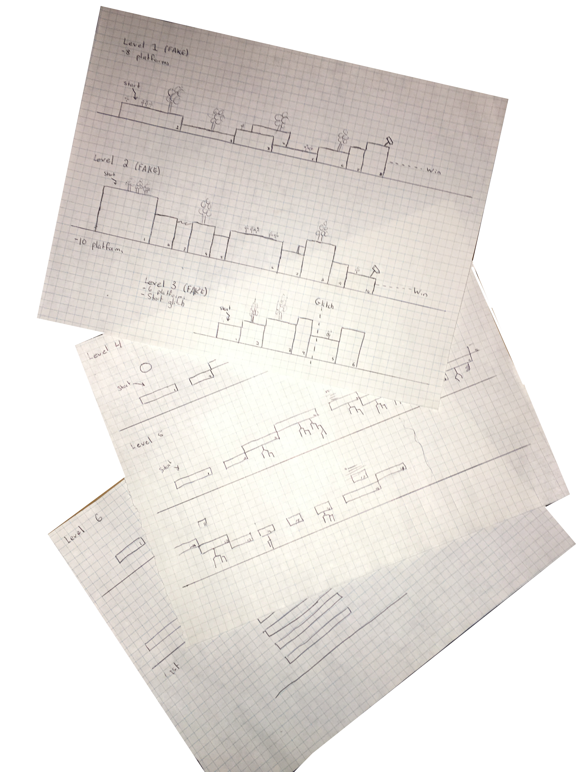
New Stuff
The game is more an experience than a game
The experience is about 5 to 10 min depending on the user’s skills ;)
Today’s version has been modified so there are no penalties.

Slide 5
Let’s try it

Slide 6


Questions?

Slide 7
Thank you

